Slide 1






Predicting Churn and Measuring Notification Impact for Long-Tenured Oura Ring Users
Using drift-based behavioral modeling and causal uplift analysis to identify groups who respond best to highlight notifications and extend their lifetime on the platform.
Team 3 - Agile Warriors
Jess Penners, Yash Jadhav, Robert Nguyen, Fiona Yi-Chen, Madina Sainazarova
Notes:
Good evening. We’re Team Agile Warriors, and our project focuses on understanding churn among long-tenured Oura users and evaluating whether personalized 3-month highlight notifications can meaningfully extend user lifetime.
Our work combines behavioral drift analysis, churn-timing prediction, and causal uplift modeling to better identify which users benefit most from timely, activity-based recaps.
We’re excited to share what we learned and how these insights could support Oura’s product and marketing strategy moving forward.

Slide 2
Team Presentation Structure
Jess: Problem & Business Impact
1
Establishing the core problem, project goals, significance, early insights, and key stakeholders
2
Yash: Data & EDA
Exploring the synthetic dataset, notification engagement patterns, and user segmentation insights
Robert: Modeling
3
Technical deep dive into drift-based churn prediction and causal uplift modeling approaches
4
Fiona: Prototype & Data Pipeline
Building dashboard prototype in Figma and proposing the technical flow to keep it updated in production
Madina: Governance & Roadmap
5
Addressing ethical considerations, limitations, and implementation pathway forward
Notes:
I’ll start by outlining the flow of our presentation.
First, I’ll frame our business problem, the significance, and the key insights that guided our approach.
Yash will then walk through the dataset and our exploratory data analysis. Robert will dive into our modeling strategy — both the churn-timing component and causal uplift. Fiona will share our cohort-specific findings and prototype. And finally, Madina will wrap with governance, ethics, and our implementation roadmap.

Slide 3

ŌURA
Business Problem Statement
Business Problem
Oura users are increasingly drawn to competing wellness devices, making it difficult to maintain long-term engagement and loyalty.
This competition threatens sustained user activity and retention.
Our Goals
Develop a dashboard to pinpoint user groups most receptive to personalized, activity-based 3-month highlight notifications.
The aim is to extend user lifetime, reduce churn, and boost customer lifetime value (LTV).
Notes:
Let’s back up for a moment. Oura is a premium wearable with a strong brand position, but competition in wellness tech has intensified. Users have more options than ever, and it’s increasingly challenging to keep long-tenured subscribers engaged beyond the onboarding period and first few months.
Our business problem is straightforward: once we remove the noise from the first three months of acclimating to the platform, how do we sustain engagement and reduce churn among loyal, paying users? This directly affects subscription revenue and long-term loyalty.
So our goal is to build a dashboard that pinpoints which user groups are most receptive to personalized, activity-based 3-month highlight notifications, with the intention of extending user lifetime and improving LTV.

Slide 4
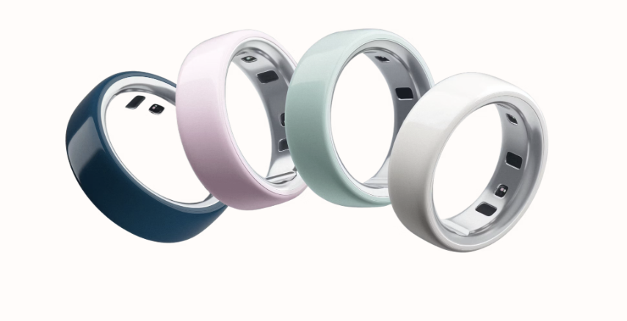


Significance and Key Data Signals
Why It Matters
Key Data Signals
Retention drives subscription revenue and shapes brand perception, especially for a premium wearable where users expect ongoing value and personalization. Losing users not only impacts immediate revenue but also erodes brand trust and market position.
Behavioral trends like session frequency, duration, and changes in daily routines.
Financial indicators including recurring monthly subscription status and tenure-based churn labels.
Notes:
Why does this matter? Retention is one of the strongest levers for subscription growth. For a premium brand like Oura, users expect ongoing value and personalization, and disengagement not only impacts revenue but also erodes trust and perceived value.
From a data perspective, we focused on two categories of signals that help us detect when a long-tenured user is drifting away from their baseline.
Behavioral trends — such as session frequency, duration, and changes in daily routines. These metrics reveal how users interact with the Oura Ring and app over time and indicate whether they’re remaining engaged or beginning to disengage.
Financial indicators — including monthly subscription status and how tenure correlates with churn risk. This data connects user activity directly to revenue and helps flag at-risk accounts before they churn.
Together, these signals guide us in forming our hypothesis which groups may benefit most from personalized touchpoints like the 3-month highlight notification.

Slide 5




Context & Insights
What We Know
Assumptions
The first three months are highly volatile. Users remaining beyond this window are familiar with the platform and see clear product value.
Long-tenured users have established routines. Their disengagement reflects a meaningful drift, not typical onboarding noise.
Validated Hypotheses
Insights & Constraints
Oura’s premium user base values personalization and responds positively to tailored experiences. This was confirmed by churn benchmarks and user feedback.
Personalized, timely communication is key to reducing disengagement. We approximated Oura-specific behavioral data by merging demographic patterns due to public dataset limitations.
Notes:
To ground our project, we began by acknowledging that the first three months of usage are the most volatile. Users who stay beyond this window are familiar with Oura’s value and interface. This allowed us to focus specifically on legacy users whose drift signals are meaningful.
Our assumptions centered on routine formation: long-tenured users have stable habits, so shifts in those patterns indicate disengagement rather than onboarding noise.
We validated key hypotheses through a blend of churn benchmarks, behavioral trends, and qualitative feedback from active Oura users. Consistently, we saw that Oura’s premium user base values personalization and responds strongly to tailored experiences.
A major constraint was the lack of public datasets combining Oura-specific behavioral sessions with Oura-specific churn outcomes. To address this, we approximated the population by merging demographic and behavioral patterns across datasets to maintain directional accuracy, and ensured our merged dataset is an accurate representation using pairwise correlation, which Yash will demonstrate shortly.

Slide 6




Stakeholders & Projected Outcomes
By developing a dashboard that pinpoints which cohorts are most responsive to the personalized three-month highlight reel,
Marketing and Product teams will gain a clear foundation for expanding this strategy and increasing long-term retention and engagement.
They will be able to test additional touchpoints like six-month, nine-month, and annual recaps, compare responsiveness across activity personas, and refine personalization based on which groups engage most.
Early feedback suggests meaningful differences between personas, such as runners versus cyclists, underscoring that Oura’s customer base contains distinct behavioral profiles that can be activated through tailored engagement.
Alyssa DiMaria
Brynn Harrington
Verneri Jaamuru
Yvonne Kim
Head of Lifecycle Marketing
Product Marketing Leader
Senior Product Marketing
VP of Product
Notes:
Our primary stakeholders for this project are Oura’s Marketing and Product leadership teams, a few of whom are highlighted below. By building a dashboard that identifies which cohorts respond most positively to the 3-month highlight notification, these teams can scale this approach across new touchpoints and new segments.
They can test six-month, nine-month, and annual recaps, evaluate how different activity personas engage, and refine personalization strategies based on what works.
What stood out to us in early feedback is how differently personas behave — for example, runners and cyclists respond to highlight reels in different ways. This reinforces that Oura’s user base contains distinct behavioral profiles, and that tailored engagement can improve retention.

Slide 7
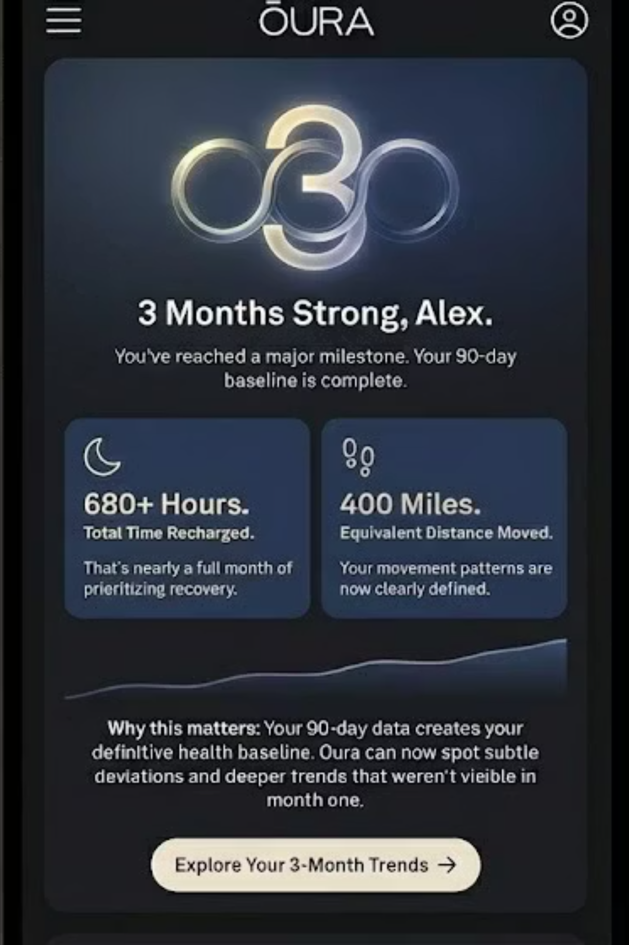
Notification Example
A personalized 90-day milestone message that celebrates progress, summarizes key trends, and encourages users to explore insights based on their newly established baseline.
Notes:
To ground this a bit more, here is an example of the personalized 90-day milestone message sent. It celebrates progress, summarizes key trends, and encourages users to explore insights based on their newly established baseline.
Our project asks: which users actually respond to this kind of notification, and by how much does it extend their lifetime?
With that, I’ll hand it over to Yash, who will walk you through our dataset, experiment design, and his exploratory analysis.

Slide 8

Data Sources
Synthetic Dataset Construction
We built a comprehensive synthetic fitness dataset by combining validated patterns from multiple real-world sources including Gym Churn datasets, Endomondo activity logs, and Customer Churn behavioral data.
The dataset was carefully calibrated to reflect authentic user patterns across activity types, with distinct behaviors for running versus walking, streak maintenance, and realistic inactivity gaps.
Distribution Validation
All distributions were validated against real-world churn and wearable device datasets to ensure realistic behavioral patterns
Pattern Calibration
Activity patterns calibrated to match real engagement trajectories including seasonal effects and lifecycle stages
Correlation Analysis
Pairwise correlation structures remain consistent with known churn drivers from academic and industry research
Notes:
“Moving into Slide 8 — this is where we establish the foundation of our data.
Because real Oura device data isn’t publicly available, we constructed a synthetic dataset — but we didn’t do it blindly. We built it using validated patterns from multiple real-world sources, including Gym Churn datasets, Endomondo activity logs (Endomondo was a GPS-based fitness tracking app where users logged workouts like running, cycling, walking, and gym sessions.), and general customer churn datasets. This allowed us to combine realistic subscription behavior with wearable engagement patterns.
To make sure the dataset behaves like actual Oura or Apple Watch users, we applied three layers of validation:
First: Distribution Validation. We checked that activity levels, churn distributions, and engagement curves match what you see in real wearable platforms.
Second: Correlation Analysis. This ensures that relationships between variables — like how session gaps or intensity shifts relate to churn — stay consistent with academic and industry research.
Third: Pattern Calibration. We shaped activity cycles to reflect natural seasonality, streak maintenance, and realistic inactivity gaps.
Together, these steps give us a dataset that isn’t just synthetic — it’s credible and behaves the way real long-term wellness users behave.”

Slide 9
Business Matrix Framework
BUSINESS Matrix: Facts, Dimensions, Features, and Availability
Facts
Dimensions
Features
Availability
Session counts
User demographics
Drift metrics
Real-time
Activity duration
Time periods
Baseline patterns
Daily batch
Notification events
Activity types
Engagement scores
Event-driven
Churn events
Risk cohorts
Streak metrics
Weekly refresh
This framework structures our analytical approach, ensuring consistent definitions across stakeholder teams and enabling reproducible insights.
Notes:
On this slide, what we’re showing is not just a table — this is the structure that connects raw user behavior all the way to marketing action.
We start with Facts, the core events like session counts, activity duration, notifications, and churn. These are the raw signals that come from the app and wearable devices.
Then we add Dimensions like demographics, activity types, and time periods so teams can slice the data and understand who behaves differently and when.
Next, we engineer Features — drift metrics, baseline patterns, and engagement scores — which are the backbone of our churn model. These take raw behavior and transform it into measurable predictors.
Finally, we map Availability, so stakeholders know which data is real-time, daily, or weekly. This ensures our dashboard stays fresh and supports timely decision-making.
So, the Business Matrix is really our blueprint — it ensures that Product, Marketing, and Data Science are working from the same definitions and can reproduce insights consistently.”

Slide 10




Data Understanding: Key Definitions
Notification Logic
Baseline Period
Users with 90+ day tenure are eligible for highlight notifications, randomized 50/50 to treatment/control.
A 90-day baseline establishes normal user activity patterns before drift measurement.
CTA Rate Definition
CTA Rate = sessions within 7 days of notification / notifications sent. Measures immediate engagement.
Notes:
Slide 10 clarifies the core definitions behind the entire project:
Notification Logic: Only users with 90+ days of tenure are eligible, and they are randomized 50/50 into treatment and control. This avoids bias.
Baseline Period: The first 90 days define what ‘normal’ looks like for each user. All drift is measured relative to this baseline.
CTA Rate: This is based on session starts within 7 days of the notification — not views or impressions. It’s a true measure of engagement behavior, not passive interaction.”

Slide 11
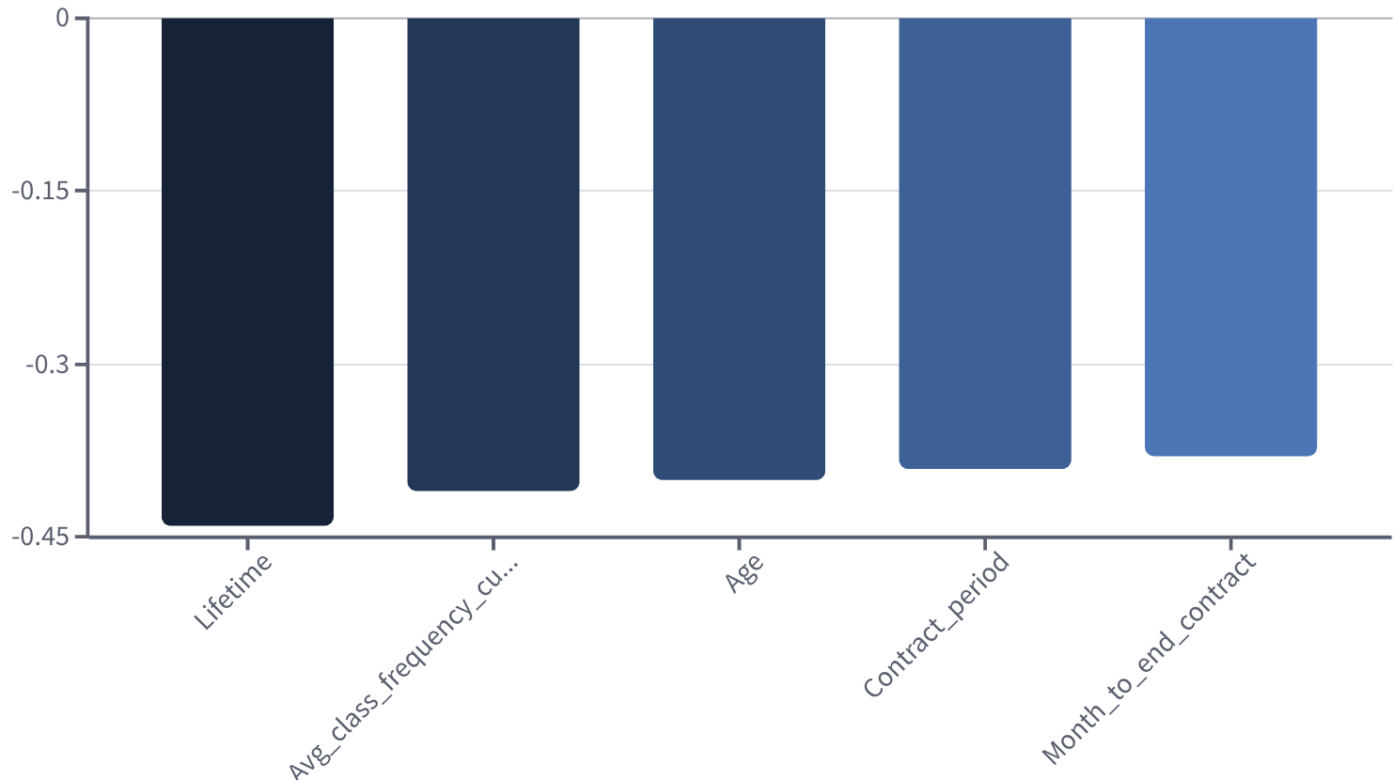
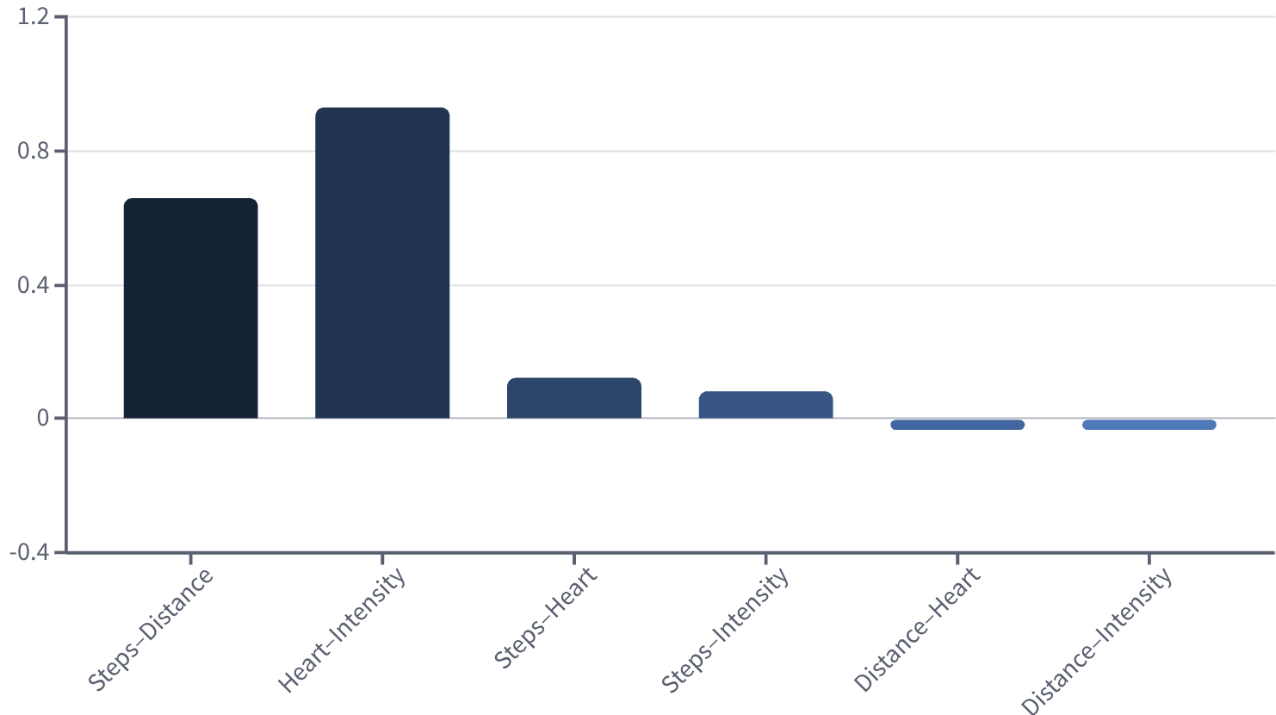
Pairwise Correlation Patterns in Churn & Wearable Behavior
General churn patterns (reference dataset)
Wearable activity patterns (Apple Watch style dataset)
Churn decreases with higher tenure, contract length, and class frequency — consistent with subscription churn research.
Wearable activity shows expected correlations: steps and distance, and intensity with heart rate.
Notes:
“Before we trusted our dataset, we confirmed that its correlation patterns match real-world behavior.
On the churn side, expected dynamics appear — churn decreases as tenure, consistency, or class frequency increases.
On the wearable side, we saw natural relationships like:
steps ↔ distance
activity intensity ↔ heart rate
These validations tell us that our data passes the ‘sanity check’ and can support predictive modeling.”

Slide 12
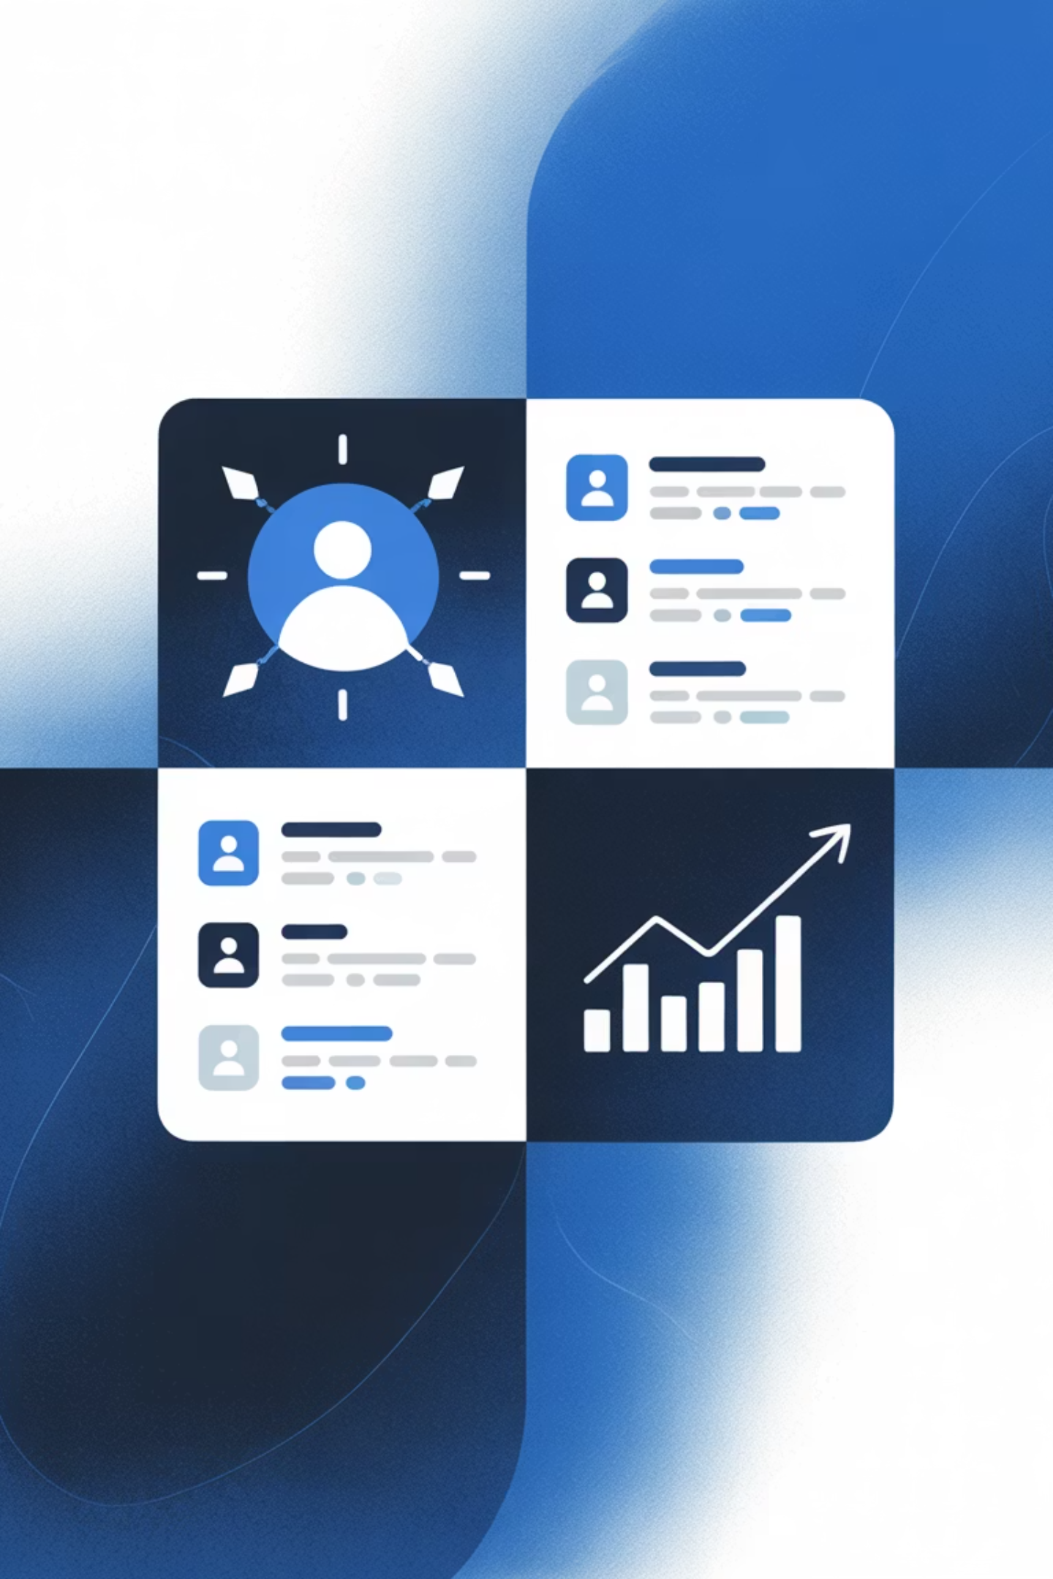
User Population Overview
10K
Long-Tenured Users
Total population analyzed in the study
51.65%
Male Users
Gender distribution in the cohort
46.25%
Female Users
Balanced representation across genders
Notification Assignment at Day 90
44.84%
The randomized assignment creates a clean experimental design, enabling causal inference about notification impact. The slight imbalance is within acceptable ranges for statistical analysis.
Treatment Group
4,484 users received highlight notifications
55.16%
Control Group
5,516 users in control without notifications
Notes:
“Slide 12 gives us context for who is included in the experiment.
We analyzed 10,000 long-tenured users — meaning users who already passed the volatile onboarding phase. The gender distribution is fairly balanced, which helps reduce demographic skew.
At Day 90, users were randomized into:
4,484 treatment users who received the highlight notification
5,516 control users who did not
This creates a clean A/B split and allows us to measure the true causal impact of notifications. Even though the groups aren’t exactly 50/50, the imbalance is small and statistically acceptable.”

Slide 13
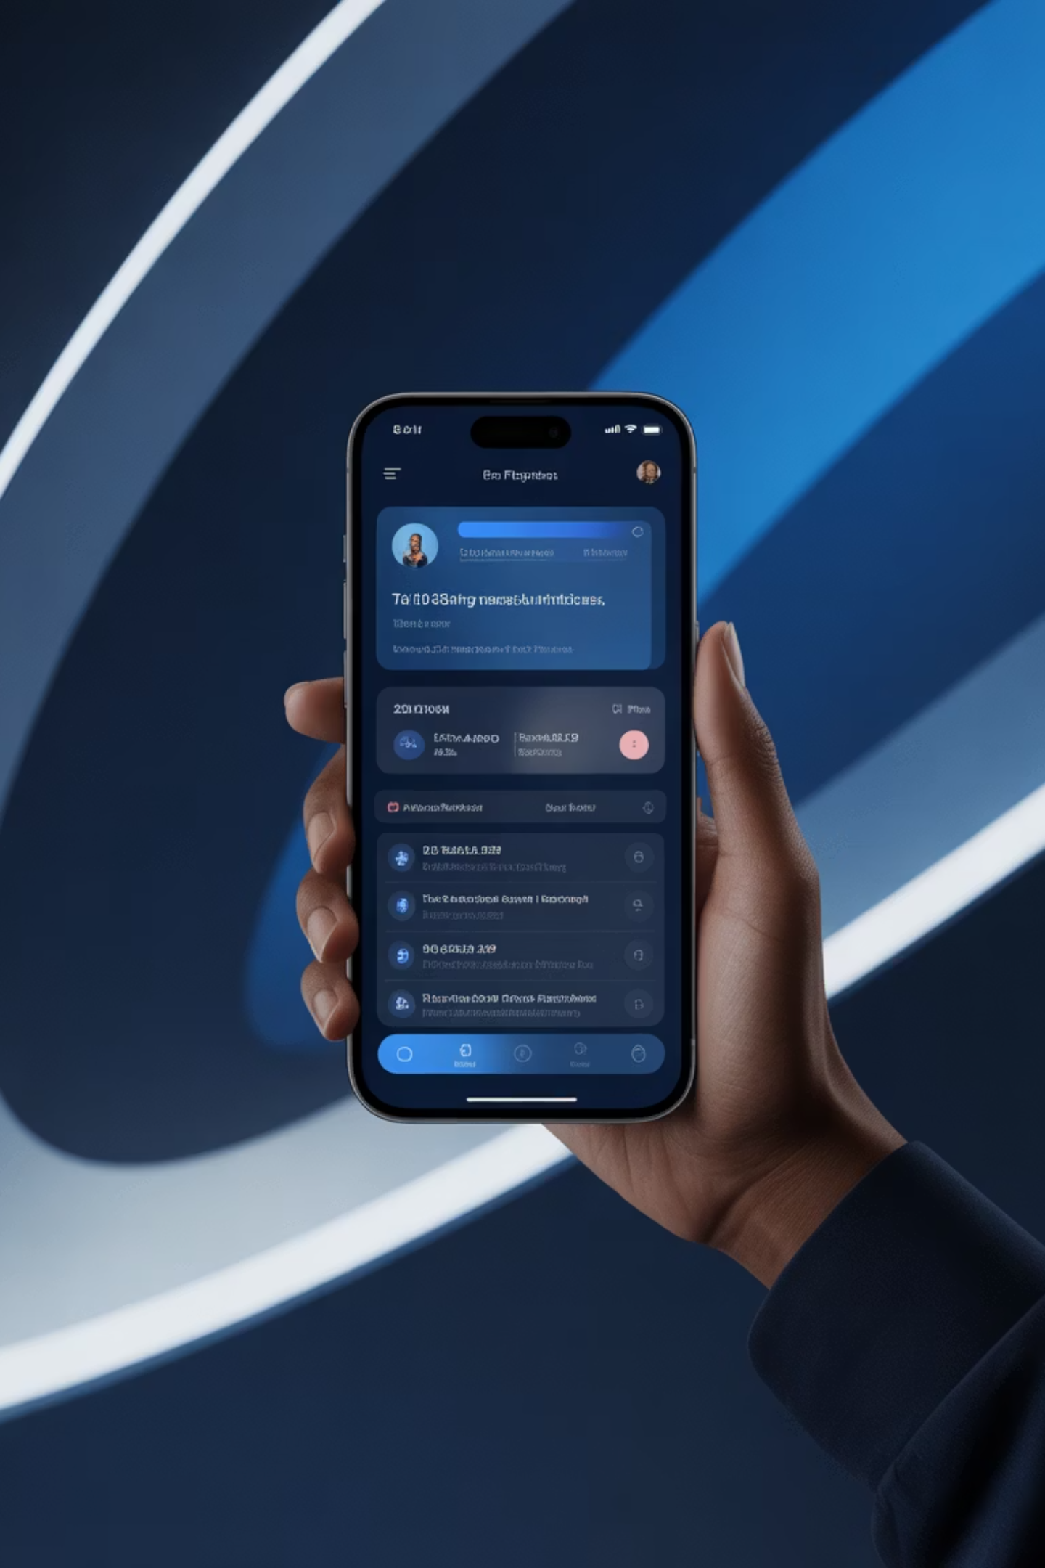

Notification Engagement Impact
Immediate Response Metrics
Session Frequency Lift
Workout Style Consistency
Users who engage with notifications show an average 225% increase in sessions during the 7 days following notification delivery.
Session duration and intensity distribution remain stable — notifications bring users back without fundamentally changing their exercise preferences.
Behavioral Interpretation
Highlight notifications act as reactivation triggers rather than behavior modifiers, effectively reminding users of platform value without forcing habit changes.
Key Insight: The CTA-based engagement definition focuses on actual behavior change (session starts) rather than passive notification views, providing a true measure of impact.
Notes:
“Slide 13 shows what happens immediately after the notification goes out — and the behavior is very clear.
Users who received the notification show a massive 225 percent increase in session frequency over the next 7 days. But their style of exercise doesn’t change — session duration and intensity remain stable.
This tells us something important: The notification doesn’t change how they work out. It simply brings them back.
So highlight notifications function as reactivation triggers — they remind the user of their progress and pull them back into the product experience without forcing behavioral changes.
This aligns perfectly with what we want in a retention strategy: small nudges with large impact.”

Slide 14



High-Response User Segment
Segmentation Approach
We applied K-Means clustering with k=5 to identify distinct user groups based on engagement patterns, demographics, and activity preferences. Our goal: discover which segments respond most strongly to highlight notifications.
Cluster 4: The High Responders
This segment consists of younger and middle-aged athletic male runners who demonstrate the highest CTA rates and strongest engagement lift following notifications.
Demographic Profile
Activity Patterns
Response Behavior
Predominantly male, ages 25-45, with consistent running routines
Regular running sessions with moderate-to-high intensity
Highest notification CTA rates across all segments
Note: CTA Rate is based on session starts within 7 days of receiving notification, measuring genuine reactivation rather than passive viewing.
Notes:
“Now, Slide 14 identifies which users benefit the most.
We applied K-means clustering and divided the population into five segments. One cluster stood out sharply — Cluster 4.
Cluster 4 users:
are predominantly younger to middle-aged male runners,
have consistent running routines,
and show the highest CTA rates and strongest uplift after the notification.
This is a textbook example of where personalization works. These users have strong routines but occasionally drift — and when they do, a well-timed notification is extremely effective in reactivating them.
Not all users behave this way:
High-engagement users don’t need a nudge.
Low-engagement users don’t respond to one.
But this middle group — disciplined, goal-oriented, and responsive — is where the notification has the highest ROI.”

Slide 15









CRISP-DM Methodology
Business Understanding
Data Understanding
Defined retention challenge and stakeholder needs
Explored patterns and validated synthetic dataset
Deployment
Data Preparation
Actionable insights for marketing teams
Engineered drift features and baseline metrics
Evaluation
Modeling
Validated results and cohort insights
Built churn prediction and uplift models
Post-Panel Refinements
Focused exclusively on long-tenured users to increase signal quality
Added randomization layer for clean causal uplift measurement
Enhanced EDA with notification effect deep dives
Aligned modeling outputs directly with lifecycle marketing actions
Notes:
, Slide 15 ties our whole workflow together using the CRISP-DM framework. We followed a complete lifecycle:
Business Understanding: defining retention as the core challenge
Data Understanding: exploring and validating our synthetic dataset
Data Preparation: engineering drift metrics and aligning time windows
Modeling: building both churn prediction and uplift models
Evaluation: validating results across cohorts and metrics
Deployment: preparing insights for real-world marketing activation
After receiving panel feedback, we refined our approach by:
focusing exclusively on long-tenured users for cleaner signal,
adding the randomization layer for causal uplift measurement,
enhancing EDA around drift and notification effects,
and connecting model outputs directly to lifecycle marketing actions.
CRISP-DM gave us the structure, while Agile sprints helped us iterate quickly.”
My teammate robert will continue our presentation and will throw more light on modeling approach

Slide 16


Data Preparation Pipeline
Baseline Construction
Built 90-day activity baselines for each user, capturing their normal engagement patterns
Drift Engineering
Engineered drift features measuring deviation from baseline across multiple dimensions
Pre/Post Alignment
Aligned pre-notification and post-notification windows for temporal consistency
Uplift Dataset
Constructed treatment/control matched dataset ready for causal analysis
Feature Engineering Strategy
Our preparation focused on capturing behavioral drift rather than raw activity counts. Key engineered features include:
This approach ensures our model detects changes in user behavior relative to their personal baseline, making predictions more accurate than absolute thresholds.
Session frequency decline rates
Inactivity gap growth trajectories
Streak collapse indicators
Intensity pattern shifts
Notes:
Before modeling, we focus on strong data preparation. We first build a 90-day baseline for each user to capture their normal activity.
Then we engineer drift features that measure how behavior changes from that baseline, like drops in sessions, longer inactivity gaps, and streak breaks.
We align all pre- and post-notification windows to avoid data leakage and ensure fair comparison. Finally, we create a clean treatment and control dataset so we can measure notification impact later.
This setup lets the model focus on behavioral change, not just raw activity.”

Slide 17


Modeling Framework Overview
Two-Model Approach
Our solution combines churn prediction with uplift modeling to address both timing and intervention effectiveness questions.
Why Drift Over Raw Counts?
Drift features capture deviation from personal baseline, making predictions robust to individual differences in activity levels.
1
Baseline Window
Days 1-90: Establish normal patterns
2
Drift Window
Days 91-180: Measure behavioral changes
3
Outcome Window
Days 181+: Observe churn events
Segmentation Advantage
Rather than relying on population averages, we segment users into risk tiers. This avoids misleading aggregate statistics and enables targeted retention strategies where marketing resources are allocated efficiently.
Notes:
Now that we’ve built clean baselines and drift features, we move into the modeling stage.
Our approach uses two models because we are solving two related but different problems.
First, we want to know when a long-tenured user starts drifting toward churn.
Second, we want to know whether the three-month notification actually changes behavior.
To do this, we focus on behavioral drift rather than raw activity counts, and we organize users into clear risk tiers so the results are easy for Marketing to use.”

Slide 18
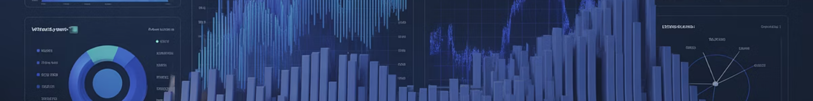
Churn Prediction Model
1
Drift-Based Predictors
Model leverages session decline rates, inactivity gap growth, and streak collapse patterns — all measured as deviations from each user's established baseline.
2
Trajectory Detection
Rather than analyzing single snapshots, the model detects deviation from a user's normal trajectory, capturing subtle disengagement signals before full churn occurs.
3
Time-to-Churn Probability
Outputs calibrated probabilities via classification framework, enabling risk tier assignment for targeted intervention timing.
4
Algorithm Selection
XGBoost was chosen after comprehensive baseline comparisons, delivering superior performance on imbalanced churn data with strong interpretability.
Risk Tier Framework
Users are classified into risk tiers based on predicted churn probability, enabling marketing teams to prioritize outreach and customize messaging intensity by segment.
Notes:
“To detect churn early, we build a 90-day baseline for each user. This baseline shows their normal pattern. Then we measure drift: drops in session frequency, longer inactivity gaps, and broken streaks. These changes appear before full churn, so they are strong signals.
We do not just predict if churn happens. We try to predict when the drift becomes serious.
We compared simple models and tree-based models. XGBoost gave the best balance of accuracy and clear explanations. It works well with our imbalanced churn data and let us show which features matter most.”

Slide 19

Uplift Modeling & A/B Design
Causal Framework
Our randomized notification assignment at day 90 creates a clean treatment/control split, enabling rigorous causal inference about notification impact.
What Uplift Measures
Uplift modeling quantifies the incremental lift in engagement and churn delay attributable specifically to highlight notifications, beyond natural retention patterns.
01
02
03
Identify Responsive Cohorts
Measure Incremental Impact
Enable Efficient Targeting
Determine which user segments show strongest positive response to notifications
Quantify the additional engagement and lifetime extension beyond control group
Focus retention resources on cohorts where notifications deliver highest ROI
This approach transforms retention from broad campaigns into precision targeting, maximizing impact while minimizing notification fatigue across the user base.
Notes:
“The second model looks at notification impact. The notification at day 90 is randomized, so we get a clean treatment and control split. That makes it possible to measure the true effect of the notification.
Uplift modeling tells us three things:
How much extra engagement the notification creates
Whether churn is delayed
Which groups respond the best
This is important because not everyone reacts the same. Some users benefit a lot. Some barely move. So uplift helps us avoid sending notifications where they don’t help, and focus on users who gain real value.”

Slide 20

Model Evaluation Strategy
Multi-Faceted Validation Approach
Performance Metrics
Interpretability Analysis
Retention curves: Visualize survival differences between risk tiers
SHAP values: Drift features dominate importance
Feature contributions: Validate that model relies on business-relevant signals
Precision-Recall curves: Optimize classification thresholds for business needs
Cohort-level uplift: Evaluate notification impact across segments
ROC-AUC: Measure overall discriminative power
Predictive Accuracy
Model successfully separates high-risk from low-risk users with strong AUC performance
Marketing Value
Risk tiers align with actionable marketing segments, enabling immediate deployment
Interpretability
SHAP analysis confirms drift-based features drive predictions, building stakeholder trust
Our evaluation prioritizes not just statistical performance, but practical utility for retention teams making daily targeting decisions.
Notes:
“We check performance and interpretability.
On performance, we look at retention curves, precision-recall, and ROC-AUC. These show how well the model separates high-risk and low-risk users.
On interpretability, we use SHAP to confirm that drift features drive the predictions, not random noise. We also check uplift by cohort to make sure the notification effect is consistent and fair.
The goal is not just strong metrics. The goal is results that Marketing and Product can use immediately.”

Slide 21



Notification Impact Results
Immediate Engagement Lift
1.5-2×
30%
15%
Session Frequency
Lifetime Extension
Competitive Churn
Immediate lift in activity within 7 days post-notification
Average increase for responsive cohorts
Reduction in treatment vs. control group
Cohort-Specific Insights
Notifications delivered strongest impact among moderate-consistency users.
High-consistency users showed minimal lift, while low-consistency users demonstrated limited response.
Key Finding: Highlight notifications successfully extend lifetime for specific cohorts, with treatment groups showing lower churn rates compared to control populations.
Notes:
“The notification shows a strong short-term effect. Session frequency increases 1.5 to 2 times within the first week. We also see about 30 percent longer lifetime for the most responsive groups. Competitive churn drops as well, so users are less likely to switch to another app.
The strongest results come from moderate-consistency users. They are active enough to care, but still at risk of falling off. High-consistency users already stay engaged. Low-consistency users need deeper support than a simple reminder.”

Slide 22





Cohort & Cluster Insights
High-Value Segment: Cluster 4
Highest Response Rates
Low-Engagement Reality
Activity Stability Predicts Success
Cluster 4 (athletic male runners, ages 25-45) demonstrates both the highest CTA rates and strongest uplift following notifications.
Cohorts with minimal baseline activity show limited benefit from highlight notifications — these users require more intensive reactivation strategies.
Users with stable activity patterns experiencing early drift are the strongest candidates for notification-based retention interventions.
Strategic Roadmap
Persona-Based Targeting
Lifecycle Automation
Continuous Optimization
Deploy notifications to Cluster 4 and similar moderate-consistency segments
Integrate drift scores into CRM for automated trigger campaigns
Monitor uplift by cohort and refine targeting thresholds quarterly
These insights provide a clear implementation pathway for retention teams, enabling persona-based lifecycle strategies that maximize ROI while respecting user preferences across segments.
Notes:
“Our cluster analysis shows the uplift pattern clearly. Cluster 4 — athletic male runners — has the highest CTA rates and the strongest uplift. They react fast when they start to drift.
Low-engagement users barely respond at all. They need a different type of intervention, maybe coaching or personalized programs.
The key finding is: Retention works best when it is persona-based, not broadcast. These results give us a direct playbook: send reminders to users who benefit, and design new strategies for users who do not.”

Slide 23
Dashboard Design Logic – Churn Risk & Notification Impact
Target Audience
Core Design Principles
Designed for our Product & Marketing teams who need to:
Top-down Narrative: Progresses from a high-level overview to specific user actions, guiding users from "What's happening?" to "Who do we act on?".
Monitor churn risk for long-tenured users proactively.
Identify which user segments respond best to notifications.
Segment-Centric & Experiment-Driven: Every page breaks down results by user clusters and treatment vs. control groups
Run data-driven retention campaigns with precision.
Four Pages, Four Questions
1
2
Executive Overview “Is churn a problem right now?”
Cohorts “Which clusters are most at risk?”
Shows: Predicted vs. actual 30-day churn, retention uplift, weekly trends, top-responding clusters.
Shows: Churn rate by cluster, predicted vs. actual churn, notification coverage by cluster.
Used for: Quick health checks and identifying high-performing clusters.
Used for: Prioritizing retention budget and validating model behavior by segment.
3
4
Notification “Did the 3-month notification work, and for whom?”
Actionable User List “Who do we target next?”
Shows: Pre/post sessions for treatment vs. control, 30-day churn by group & cluster, 7-day CTA rate by cluster.
Shows: User-level table (cluster, predicted churn, actual churn, last session, notification group).
Used for: Measuring experiment impact and identifying high-response segments.
Used for: Exporting high-risk users in priority clusters for re-engagement campaigns.
Notes:
So for the final output prototype, we built a Tableau dashboard that helps our Product and Marketing teams monitor churn risk in real time and understand how well our 3-month notification campaign is actually working. The idea is pretty straightforward. we wanted to give them a single place to check on user health, see which customer segments are most at risk, and decide where to focus their retention efforts.
To design and prototype this dashboard, we used Figma because it lets us quickly mock up the layout and flow without having to build the whole thing in Tableau from scratch.
The dashboard has four pages. Each page answers a different business question and gives you a different lens on the data—from the big picture overview down to individual users you should target.
· Page 1 gives you the overall health check—is churn going up or down?
· Page 2 breaks it down by cluster so you know which segments are struggling.
· Page 3 shows if the notification campaign actually worked and who responded.
· Page 4 gives you the actual user list to target for re-engagement.

Slide 24
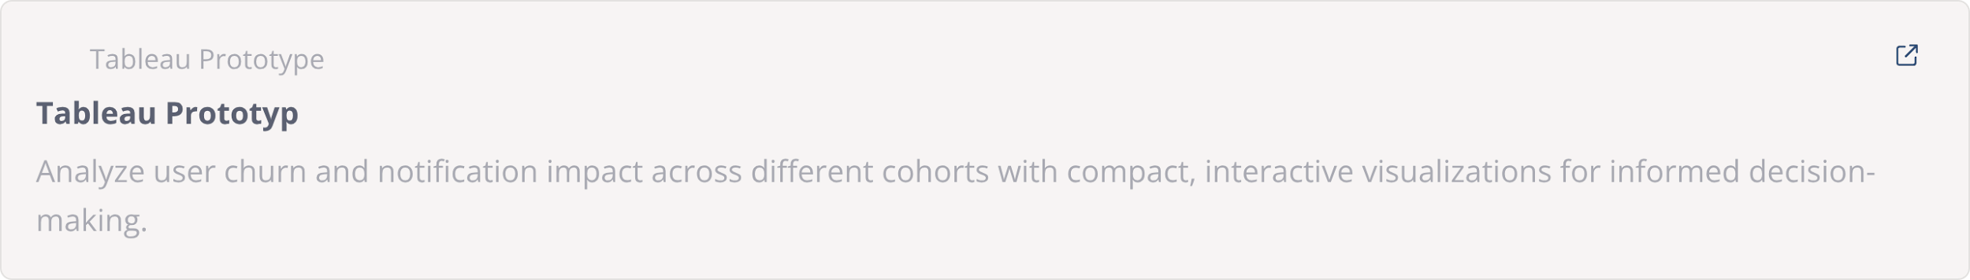
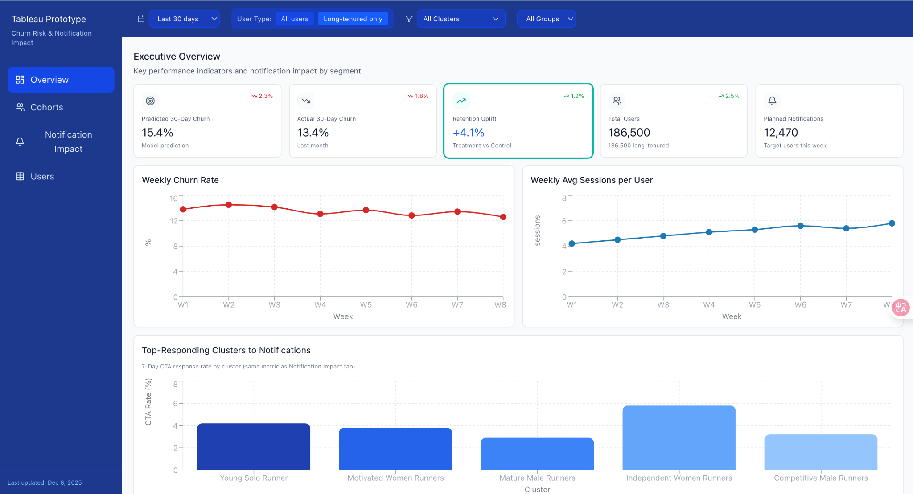
Prototype demo
Notes:
mention the number in prototype are totally mock up
On the top of the dashboard there are filters for users to choose the specific scenario
[Page 1 – Executive Overview]
So the first page is your daily dashboard. You come in just wanna know: "Okay, is churn getting worse or better?" You can see our overall churn prediction for the next 30 days, and—this is the key part—we can also see how much the notification campaign actually helped. So if people got the notification, did they come back? And how many clusters are responding well versus not?
[Page 2 – Cohorts]
Now, if you zoom in and ask "which groups are actually struggling?"—that's page two. Because different customer segments behave totally differently,this page can help us to answer Where should we actually spend the marketing budget?"
[Page 3 – Notification Impact]
Page three is where we actually prove the notification worked. We ran an A/B test, so some users got it, some didn't. This page shows the comparison—like, how much did sessions go up after the notification? Did it actually reduce churn? And maybe most importantly: which clusters actually cared about the notification versus which ones ignored it?
[Page 4 – Actionable User List]
And then the last page is just... the list. Here are the actual users you should target. Here's their predicted churn score, here's which cluster they're in, here's when they last logged in. Marketing just downloads this and runs campaigns. It's the practical output of everything we built.

Slide 25
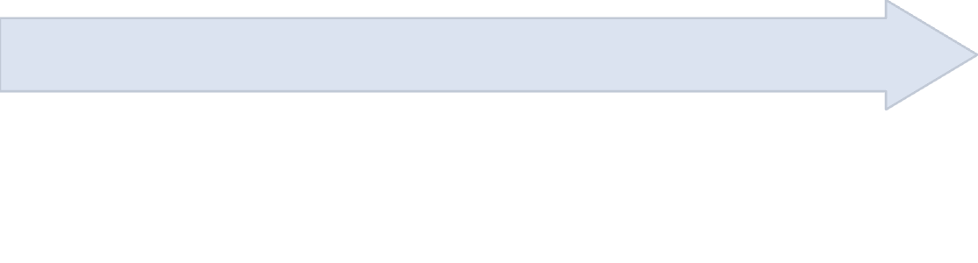

Technical Architecture – Data Pipeline from App to Dashboard
Databricks
Snowflake Data Warehouse
Databricks job runs nightly: Reads latest user_monthly_features from Snowflake. Runs pre-trained churn classification model (0/1 prediction).
App & Wearables
Data lands in Snowflake tables. SQL queries aggregate raw events into user-level features (last 90 days per user), creating user_monthly_features table.
Mobile app and wearable devices send raw workout events and notification logs.
Flow: Raw Events
Flow: Predictions (daily batch)
Flow: Daily Read
Tableau Dashboard
Snowflake Predictions Table
Tableau connects to Snowflake as data source. Reads churn_predictions, user_monthly_features, notifications tables. Data source refreshes daily for latest predictions.
churn_predictions table updated daily. Marketing & Product teams can query this table anytime for user targeting.
Flow: Auto-refresh (daily)
Flow: Auto-refresh (daily)
Design Principle: Single source of truth in Snowflake; Databricks is compute engine for ML; Tableau is always-up-to-date reporting layer.
Notes:
In order to maintain fresh predictions and ensure the dashboard updates every single day, we designed a data pipeline that flows from raw app events all the way to the Tableau dashboard.
[Flow Overview]
Here's how it works: First, the mobile app and wearables send raw workout events and notification logs. This data lands in Snowflake, which is our central data warehouse.
From there, we run daily SQL jobs that aggregate all those raw events into user-level features. So instead of millions of individual events, we're creating a clean features table that captures the last 90 days of each user's behavior—things like session count, activity gaps, and how they responded to the notification.
[Model Pipeline]
Next, Databricks picks up these features every night and runs our churn prediction model. It's a straightforward classifier—the user’s churn risk in the next 30 days? The predictions get written back into Snowflake.
[Dashboard Auto-refresh]
Finally, Tableau connects directly to Snowflake and pulls from the predictions table, the features table, and the notifications table. We set Tableau to refresh daily, so every morning when the marketing and PM team logs in, they're seeing yesterday's fresh predictions and the most up-to-date numbers.
[Key Principle]
The key design here is simplicity: one source of truth in Snowflake, Databricks is just the compute engine, and Tableau is the always-fresh reporting layer.

Slide 26






Governance + Ethical Considerations
User Consent and Transparency
Explain why a notification is sent and allow opt-out.
Monitor Wellbeing & Avoid Notification Fatigue
Enforce timing and frequency caps.
Fairness Checks
Ensure uplift decisions do not favor or disadvantage cohorts.
Ethical A/B Testing
Control group protection + roll-forward if treatment proves beneficial.
Notes:
Madina

Slide 27
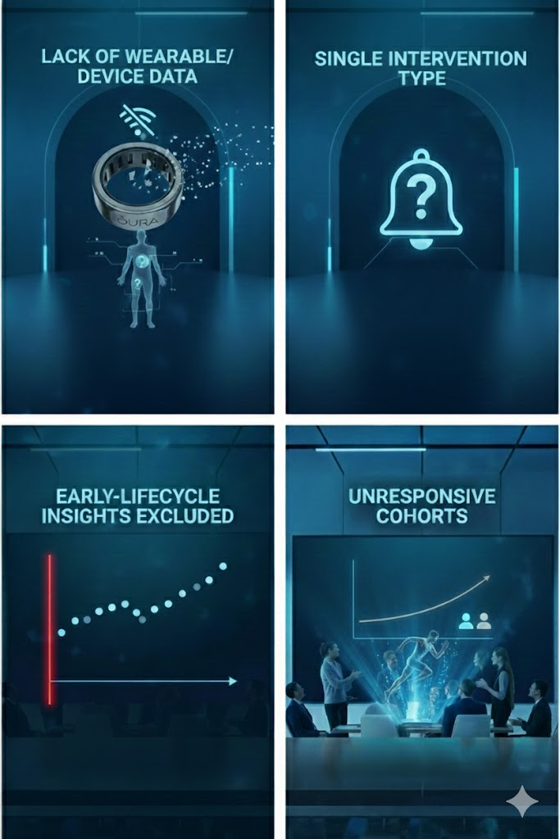
Limitations
Lack of Wearable/Device Data
Limits behavioral understanding
Early-Lifecycle Insights Excluded
Survivorship bias still present by design
Single Intervention Type
Only notification tested; deeper value-based drivers remain unresolved
Unresponsive Cohorts
Some cohorts remain unresponsive to nudges, even with accurate churn prediction
Notes:
Madina

Slide 28
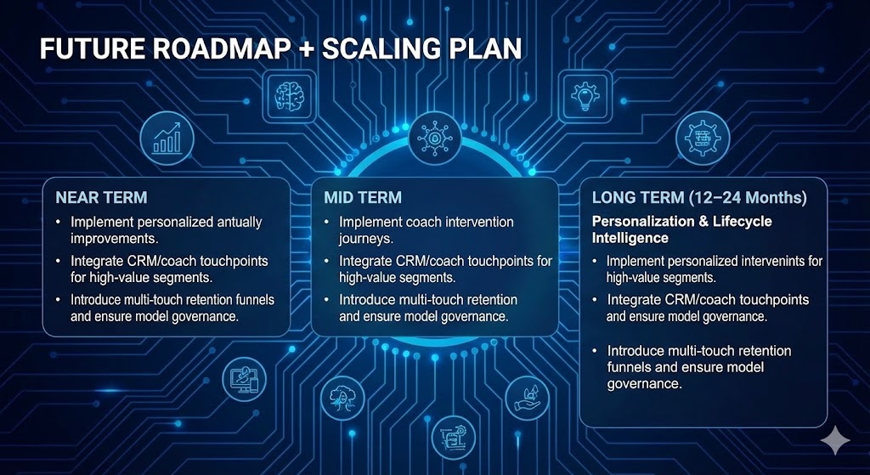
Future Roadmap
Near Term (0–6 Months) — Foundation & Pilot
Stabilize data and refine long-tenured cohort logic.
Build and validate drift-based churn timing model.
Run pilot A/B tests for notifications.
Mid Term (6–12 Months) — Expansion & Automation
Deploy daily risk scoring and notification eligibility into marketing workflow.
Enhance prototype UX and build monitoring dashboards.
Expand targeting to mid-tenured user segments.
Long Term (12 -24 Months) — Personalization & Lifecycle Intelligence
Implement personalized intervention journeys.
Integrate CRM/coach touchpoints for high-value segments.
Introduce multi-touch retention funnels and ensure model governance.

Slide 29
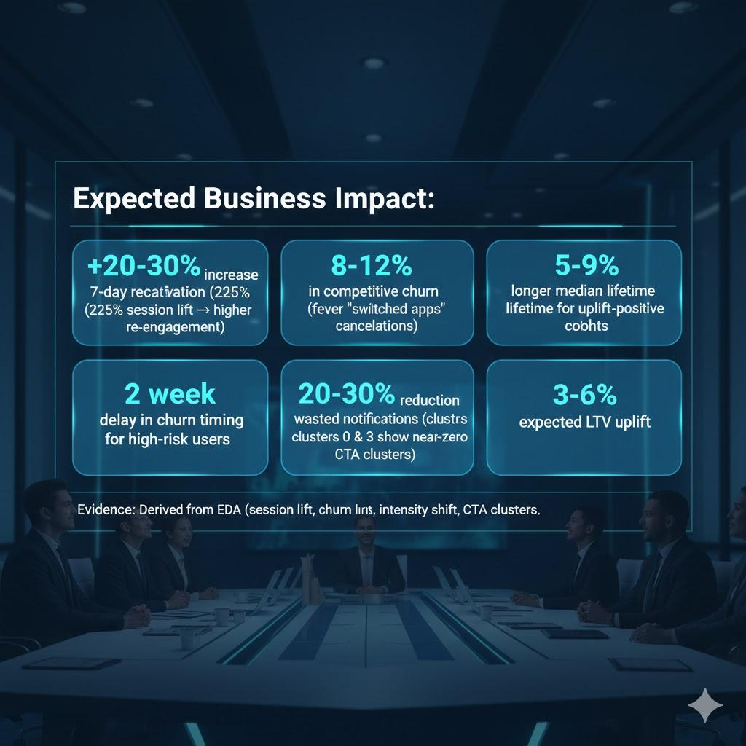
Business Value Summary + Expected Outcomes
Predictive churn timing → proactive retention
Uplift insights → efficient targeting
Higher LTV via extended platform lifetime
Reduction in wasted notifications
Expected Business Impact:
+20–30% increase in 7-day reactivation (225% session lift → higher re-engagement)
8–12% reduction in competitive churn (fewer "switched apps" cancellations)
2–3 week delay in churn timing for high-risk users
20–30% reduction in wasted notifications (clusters 0 & 3 show near-zero CTA)
3–6% expected LTV uplift
Evidence: Derived from EDA (session lift, churn reasons, intensity shift, CTA clusters).
Notes:
Madina

Slide 30

Team Reflections & Key Learnings
01
02
03
Narrowing to long-tenured users improved data stability and model clarity
Drift-based modeling captured real behavioral change rather than raw metrics
Uplift modeling prevented false assumptions about “what works”
04
05
Iterating with Agile + CRISP-DM reduced rework and clarified what truly mattered for retention.
Integrating insights into the UX narrative made the model's value obvious to non-technical stakeholders.

Slide 31

Generative AI Usage
1
ChatGPT
Used for synthesizing research data and explaining technical concepts.
2
Gemini
Utilized for comprehensive summary comparisons and refining messaging.
Instrumental for drafting prototype content and rapid layout adjustments.
3
Figma
4
Gamma
Employed for fast slide restructuring and presentation narrative alignment.
GitHub Copilot
5
Provided intelligent suggestions for variable naming, enhancing schema clarity in our codebase
Notes:
Madina

Slide 32

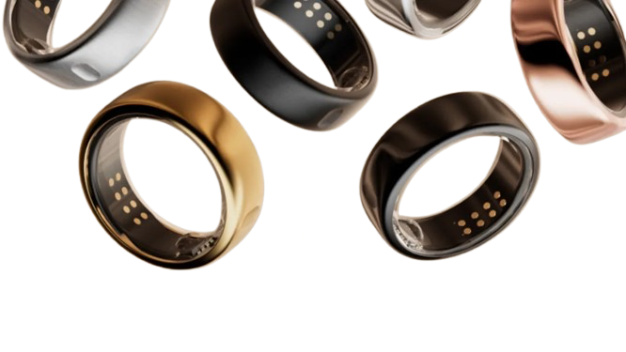
Thank You!
We are open for questions.
We now open the floor for any questions you may have.
Team 3 - Agile Warriors
Jess Penners, Yash Jadhav, Robert Nguyen, Fiona Yi-Chen, Madina Sainazarova
Notes:
Madina

